Slide 1
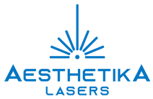
Clinical Training Presentation
Notes:
Done

Slide 2
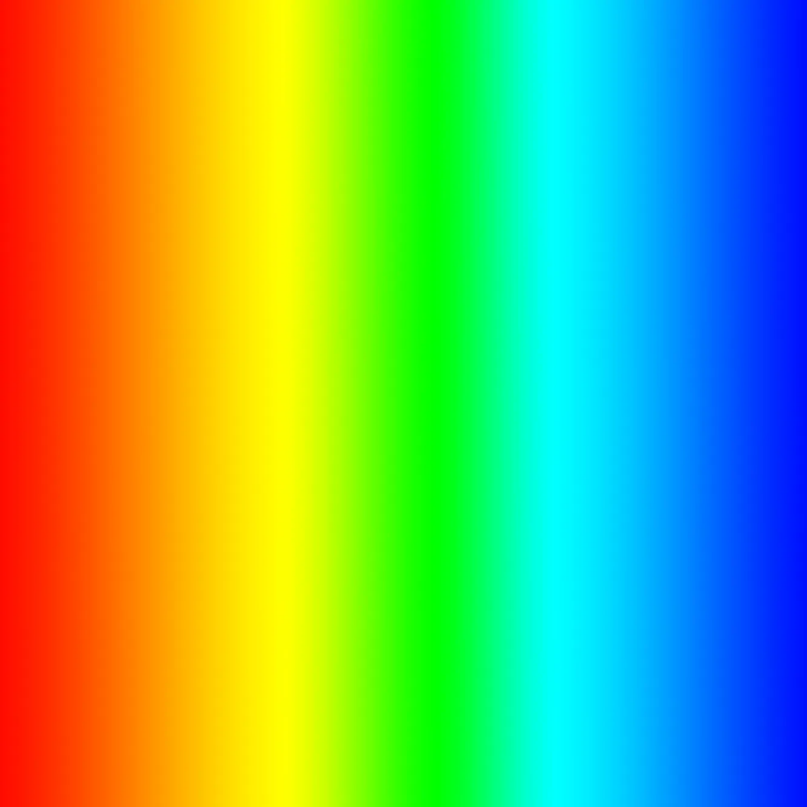
What is IPL ?
IPL = Intense Pulsed Light
Spectrum of part of visible light
& part of near infra-red
420-950 nm
Omnia is the next generation of pulsed light technology. Its breakthrough design converts unused UV light into the optimal spectrum used by each application.
This dramatic boost in efficiency also extends the life of the pulsed-light head (up to three times longer than that of other pulsed light systems), significantly lowering the cost of ownership.
Notes:
Done

Slide 3
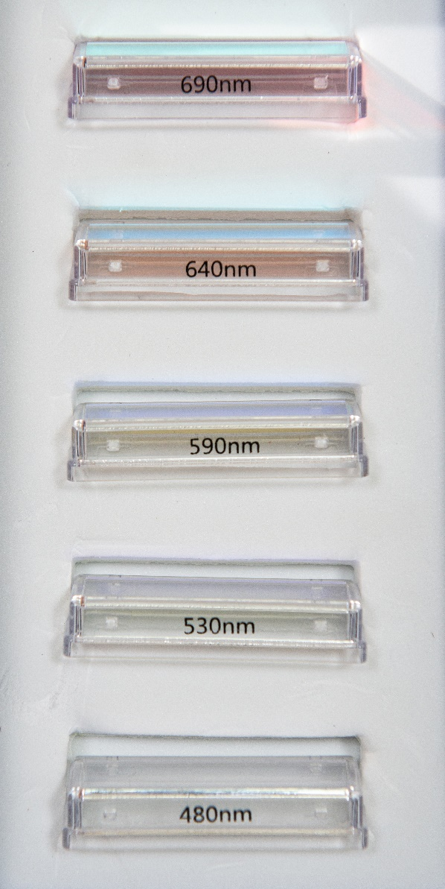
IPL Applications of the Omnia
480 – Mild to Moderate Inflammatory Acne 480-950 nm
530 – Vascular and Pigmented Lesions 530-950nm
590 – Non-Ablative Skin Rejuvenation 590-950nm
640 – Hair Removal 640-950nm
690 – Hair Removal 690-950nm
Notes:
Done

Slide 4
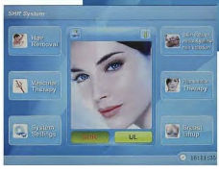
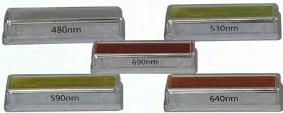
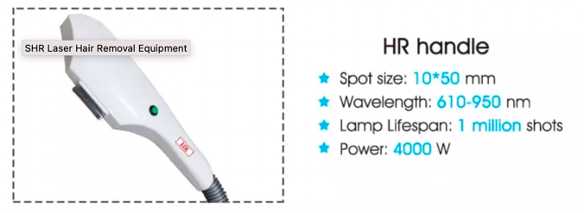
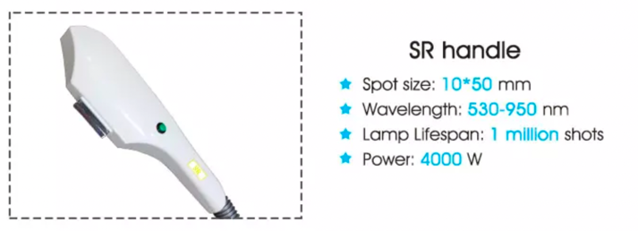
Five Wavelength Filters
Display
15 inch, colorful touch screen.
480nm - 950nm
530nm - 950nm
590nm - 950nm
640nm - 950nm
690nm - 950nm
SHR mode & SSR mode
Notes:
Explain that there are 2 handpieces available OR that both modalities are same handpiece.
Display screen photo is wrong. Please replace

Slide 5
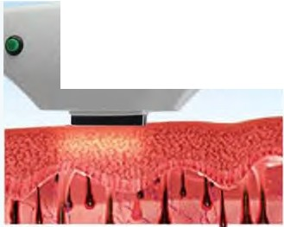
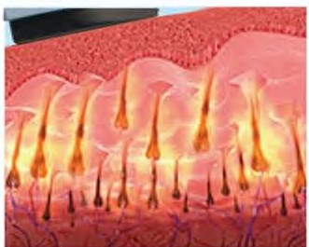
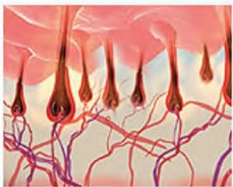
Theory
Omnia’s hand piece is designed for optimum clinical results and comfort. This IPL is designed with proprietary SHR and SSR technology which is made for the versatile treatment of all skin tones. With built in cooling, the procedures are comfortable and almost completely painless.
SHR/ SSR
During a Treatment
During a Treatment
After a Treatment
OMNIA Applications
- Hair Removal
- Hyperpigmentation Therapy
- Vascular Legion Therapy
Features of SHR and SSR Handpieces
- The SSR and SHR treatment options are able to deliver the light energy at a steadier, slower rate while using the same energy thus creating a
more comfortable treatment process.
- Minimize the risk of adverse reaction and better clinical outcomes.
- Skin Rejuvenation
- Acne Clearance
- SHR Skin Rejuvenation/ Super Hair Removal
Notes:
Done

Slide 6
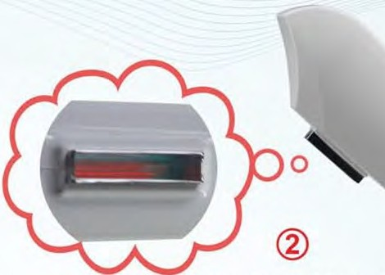
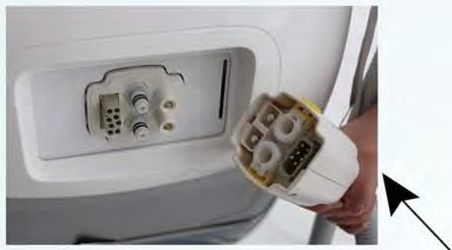
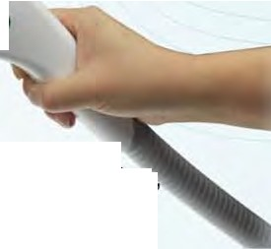
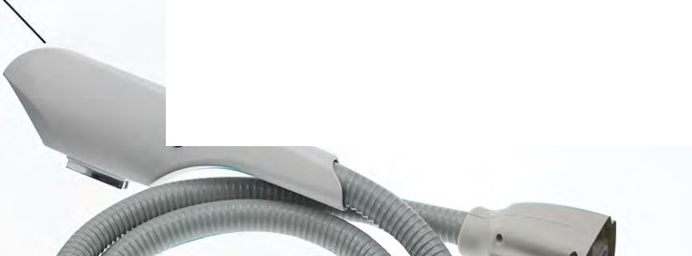
•
Handpiece connector
Double fixed sapphires~10x50 mm spot size,
strong energy, long working time, built in cooling for treatment comfort.
2 Handpieces
Large flashlamp
High Repetition Rate
Notes:
Done

Slide 7
Five Wavelength Filters
Display
15 inch, colorful touch screen.
480nm - 950nm
530nm - 950nm
590nm - 950nm
640nm - 950nm
690nm - 950nm
SHR mode & SSR mode
Notes:
Same slide as page 4. Remove page please

Slide 8
Normal IPL+ RF vs. OMNIA SHR/ SSR IPL+RF
Difference Normal IPL+RF
OMNIA SHR/ SSR IPL+RF
0.2- 1Hz
1 shot per second. Lifespan of machine and lamp greatly shortened.
Shot Speed
1- 10Hz
It fires 6-10 shots per second.
Multi Pulse Mode
Employs short impulses of 2 - 300 milliseconds, applying a vast amount of energy (12-120 J/ cm2) to destroy the chromophore.
Single Pulse Mode
Utilizing low energy with a high repetition rate (up to 10Hz, i.e. 10 shots per second) allows for a more efficacious treatment, maximum patient comfort, resulting in better clinical outcomes.
In-motion technology
Two times the speed of than other lamp probe pulses, which allows for the handpiece to recharge at a faster rate (10Hz repetition).
Pulse
Treatment Method
Stationary spot.
Power
Supply
Capacitor recharging rate is slow.
Notes:
Done

Slide 9
OMNIA SHR/ SSR vs others
Difference OMNIA SHR/ SSR
Other Suppliers
Pseudo-color screen old 16- bit color display.
Changeable external filter
Easily burns skin.
Screen
15 inch color display, same as computer or TV)
2 handpieces with newest high grade interchangeable filter.
Strong energy,long continual working time.
Handpieces
Wavelength filter plated by German- made equipment. Super durable, even when using high energy.
Wavelength Filter
Easy wear and tear, often needs repair.
System
2 systems: SHR system+ SSR IPL system
Single SHR system
PVC leather hose Short Lifespan
Germany imported hose Long Lifespan
Hose
Crystal
100 % REAL sapphire
quartz
Double Heraeus imported xenon lamps, up to
1, 000,000 shots in each handpiece.
Single xenon lamp, 30,000- 60,000 shots in each handpiece.
Lamp
Notes:
done

Slide 10
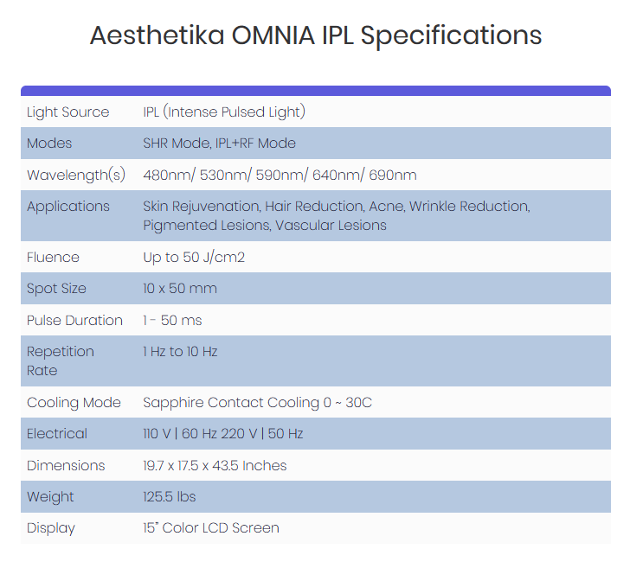
Specifications
Notes:
Done

Slide 11
Difference between Laser and IPL
Laser
IPL
Monochromatic
Broad Spectrum
Coherent
Non-coherent
Collimated (non-divergent)
Non-collimated (divergent)
Notes:
These are the main differences between IPL and lasers.
Since the laser material emits light of one wavelength only, it is monochromatic. IPL shows a broader range of the spectrum.
The laser light is coherent, meaning that all the light waves are in phase (peak together). IPL, having multiple wavelengths, cannot be in phase.
The laser beams are parallel to each other, meaning that along a distance there is minimal loss of energy, they can be delivered through an optic fiber and can be focused. IPL light, like ordinary lamp, is divergent, meaning that the longer the distance to the target, the less is the energy density per area.
DONE

Slide 12
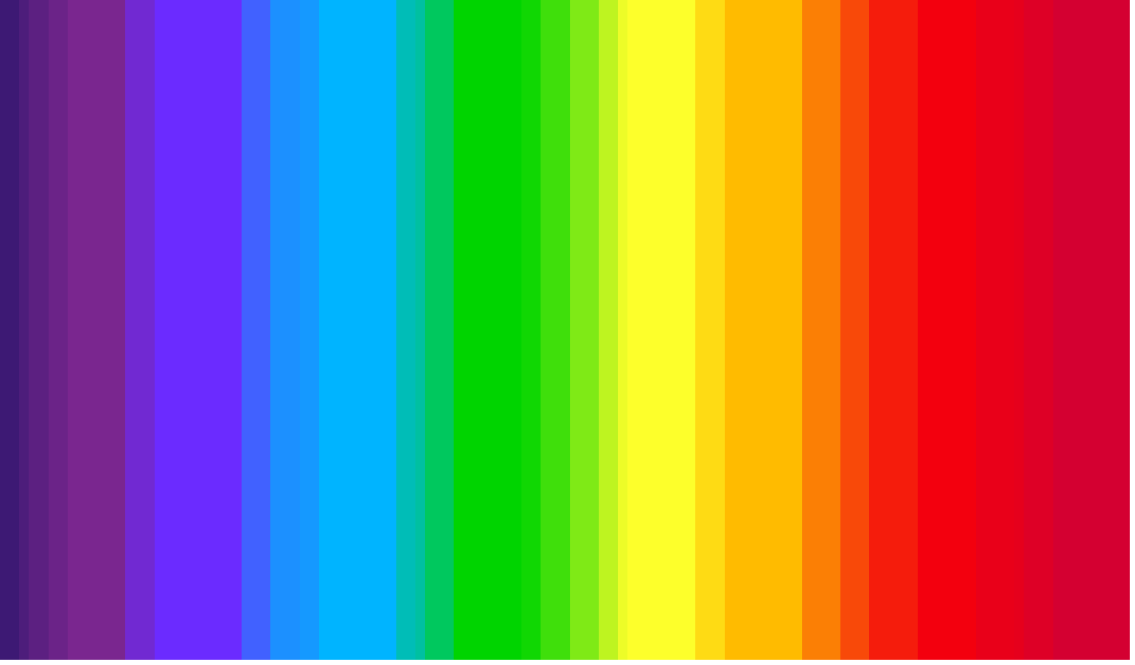
Types of Lasers
Alexandrite
Holmium
CO₂
KTP
Nd:YAG
Ruby
Er:YAG
Excimer
Argon
Dye
x-rays
cosmic rays
Microwaves
TV and
radio
waves
488 - 514
577-630
1064
2100
2940
190 - 390
532
694
755
10600
UV
VISIBLE
INFRARED
400 nm
700 nm
Notes:
Various lasers have been employed in medicine and cosmetics, each of them is radiating in one particular wavelength suitable for different lesions.
IPL, employs various filters which cut-off the spectrum below and leave the spectrum above up to 1200 nm, depending on the filter (515,550,560,570,590,615,640,645,695,755). IPL with its filters is acting as “many lasers” and is capable of treating various clinical indications at various depths.
DONE

Slide 13
How Does it Work ?
Notes:
The total spectrum of the electromagnetic radiation spreads far beyond the visible light (390-760 nm). In the visible light range, changes in wavelength are perceived by the human eye as changes in color.
The shorter wavelengths include cosmic rays, x rays and ultra violet, which are very powerful and may cause chromosomal DNA break down, mutations and cancer - NOT PRESENT IN IPL SPECTRUM;.
The longer wavelengths such as microwave radiation which is highly absorbed in water and may cause tissue thermal damage - NOT PRESENT IN IPL SPECTRUM.
IPL employs a small portion of the electromagnetic spectrum, starting at 515 nm - green at the visible portion, ending at 1200 nm at the invisible near infrared.
DONE

Slide 14
Inside the IPL head
Reflector
Linear Xenon
Flashlamp
Fluorescence coating and cut-off filter
Light Guide
Notes:
The filter coating is a cut-off filter which transmits only wavelengths above the filter number. It filters out unnecessary wavelengths. The lightsource is in your hand. Bounces off cylinder through lightguide Gives a bit of a feathering effect around borders of lightguide, for a smoother effect. Prevent lines of demarcation. This is why PDLs don’t work—they have a small spot. Impractical and restrictive and does not give you a good clear full face effect.
There is an additional internal filter to ensure that any short wavelengths, like UV, will be screened out.
Flashlamp within the head. Artistically used to feather edges.
Done

Slide 15
IPL Pulse Shape and Efficacy
Increased risk of
adverse effect
Fluence
Therapeutic range
Under treatment
IPL
1st gen-IPL
Time
Notes:
Done

Slide 16
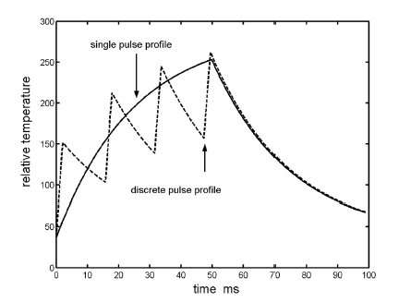
Multi Pulse Capability
IPL
Others
The IPL pulse limits peak power to only the therapeutic range, precisely heating its intended target with remarkably little discomfort
Notes:
The above figure indicates the result of applying a simple model of selective photo thermolysis to a specific absorbing site (e.g., hair bulb) for a thermal relaxation time of around 25 ms. The rate of heating of the absorbing site is proportional to the local laser field intensity. The rate of cooling of the absorbing site is assumed to be proportional to the temperature elevation of the element above that of the surrounding tissue. This simple model indicates that for continuous pulse exposure, the absorbing site is typically sustained for a longer time interval at temperatures close to the maximum temperature attained. It can therefore be anticipated that the two pulses will not have equivalent effectiveness with regard to selective thermolysis meaning that the continuous pulse profile elevates targeted sites to higher temperatures for longer time periods than that associated sequence of four individual pulses
Done

Slide 17
Pulse Duration and Pulse Shape (cont’d)
The equally distributed fluence is safer for the skin (lower peak power) which enables the safe treatment of various skin types.
The IPL pulse limits peak power to only the therapeutic range, precisely heating its intended target with remarkably little discomfort.
Notes:
Done

Slide 18
The Process of Selective Photothermolysis
Photons reach the target by penetrating the skin, carrying sufficient energy
Sufficient photon absorption generates heat in the target with minimal absorption in the epidermis / dermis
Heat coagulates the proteins in the target (hemoglobin, melanin) and is conducted to the surrounding cells, causing mechanical damage
Clearance is achieved by the immune system cells
Notes:
Reaching the target would be an easy task if the epidermis and dermis where transparent. But, since they are not transparent, light penetration through them can be compared to light trying to penetrate through a curtain on a window. The amount of light transmitted would be determined by the color and the texture of the curtain. The darker the curtain, the more light will be absorbed and the less light will penetrate inside the room. As with the curtain, the darker the skin the more light it will absorb by the melanin in the epidermis and the epidermal/dermal junction, and less photons will reach the target. The photons absorbed in our natural curtain, the skin, will produce heat which may harm the epidermis.
The main target chromophores which absorb the light, are melanin in the pigmented lesions and hair, and hemoglobin in the blood vessels.
When aiming for photothermolysis, one is not only attempting to protect the epidermis, but one is also interested in minimizing the epidermal melanin absorption as a competition, so that sufficient light energy can reach the target. Following the light absorption, the energy is converted into heat in a photothermal reaction and consequently two processes occur:
Coagulation caused by denaturation of proteins (e.g. cooked eggs).
Thermally-induced mechanical damage.
Thus the blood coagulates and the vessel’s walls disintegrate; melanin granules explode and lyse the cells that harbor them; tattoo’s ink is shuttered into small particles. All these degraded residues are eliminated by Phagocytosis; a process which may take several weeks (unlike the absorption process which take msec).
DONE

Slide 19
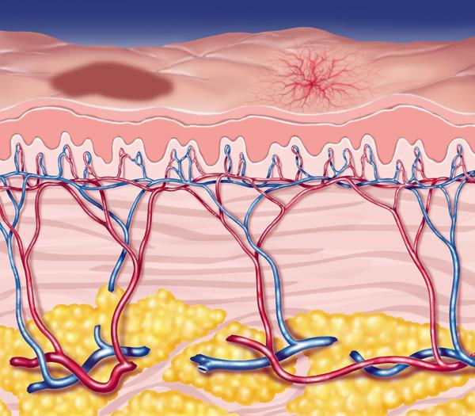
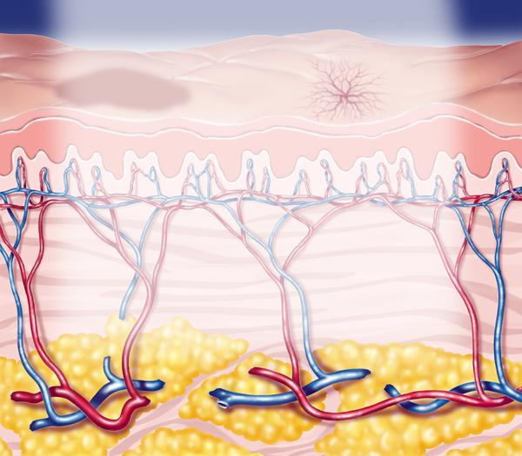
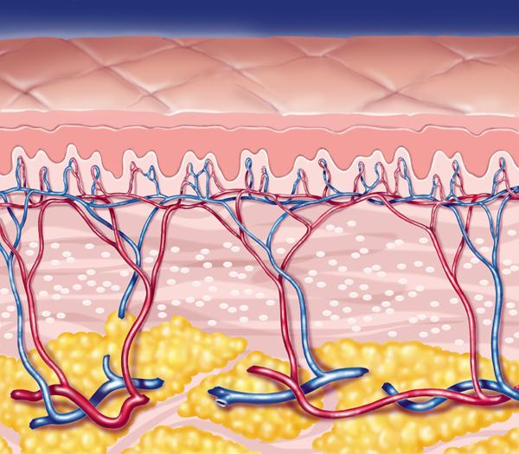
How IPL Works: Selective Photothermolysis
Notes:
DONE

Slide 20
IPL’s Efficacy: Targeting of Multiple Peaks
100,000
Er:YAG
10,000
Melanin
1,000
100
Hemoglobin
Water
CO₂
10
1.0
Oxyhemoglobin
Absorption Coefficient
(per centimeter)
0.1
0.01
0.001
0.0001
0.2
1.0
3.0
10
20
Wavelength (Microns)
Notes:
DONE

Slide 21
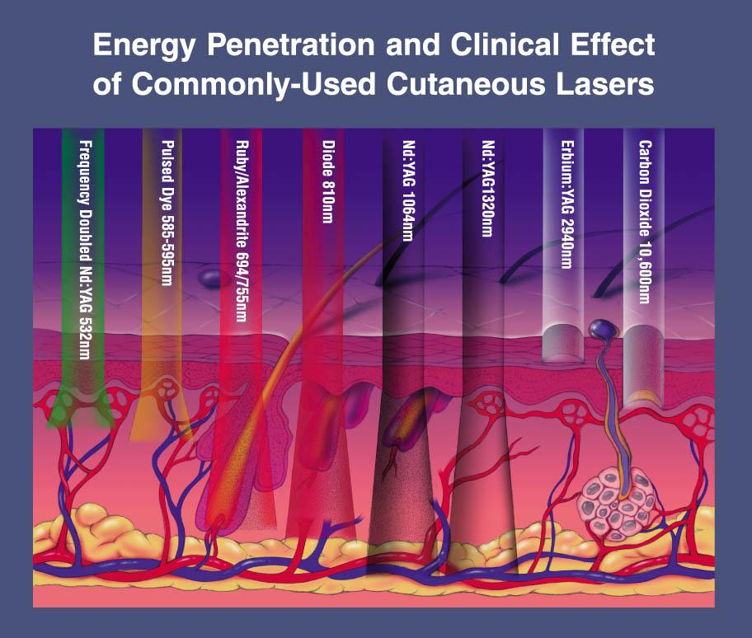
Penetration Depth - Lasers
Notes:
and for those deeper than 1 mm, Nd:YAG laser of 1064 nm wavelength is used.
Er:YAG and CO2 are well absorbed in water, therefore they are absorbed by water in the top skin layers, and do not penetrate deep.
DONE

Slide 22
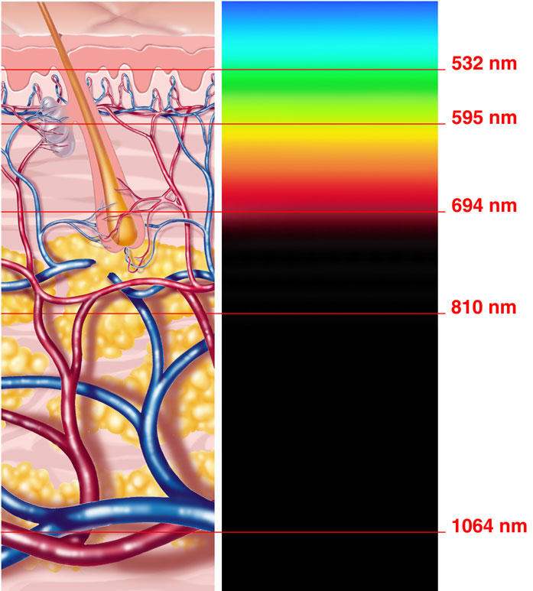
IPL’s Flexibility: Variable Depth Penetration
Notes:
DONE

Slide 23
The IPL Advantage
IPL’s sophisticated multi-application capability allows the operator to treat:
Redness associated with symptoms of rosacea
Broken capillaries and superficial spider veins
Brown pigmentation, sun damage and age spots
Mild to moderate acne
Unwanted hair
IPL provides therapeutic benefits for all parts of the body, leaving the patient’s skin soft and smooth with no down-time.
Notes:
Done

Slide 24
IPL Medical Indications
Inflammatory Acne Vulgaris
Pigmented Epidermal Lesions:
Dyschromia, Hyper-pigmentation, Melasma, Ephelides (freckles), Photoaging
Vascular Lesions:
Telangiectasia, Rosacea Symptoms, Erythema, Flushing
Skin Texture:
Collagen revitalization
Permanent Hair Reduction
Notes:
Done

Slide 25
What Can IPL Do? Additional Patient Benefits
Efficacious Yet Gentle
Precise targeting of unwanted blood vessels and melanin through chromophoric specificity, which means high efficacy while gently preserving the surrounding tissue
Natural-Looking Improvement
Progressive improvement over 4 to 6 treatments means patients look naturally younger and healthier, without the
dramatically artificial look of other
cosmetic treatments
Notes:
Done

Slide 26
Treatment Considerations
Skin Type
We only recommend treating skin types I-IV with safety top of mind!
Notes:
In order to provide true versatility
System must be able to accommodate the largest population
In considering treatment one of the first factors is skin type
Six types detailed in the Fitzpatrick Classification of skin types
This classification provides identification of fair to black skin, based on the concentration of melanin and is a necessary step to provide safe effective treatment of vascular lesions, pigmented lesions and for hair removal.
For hair removal IPL is cleared for skin types 1-6
For pigmented lesions IPL is cleared for skin types 1-4
and for vascular lesions and veins IPL is cleared for skin types 1-4
DONE

Slide 27
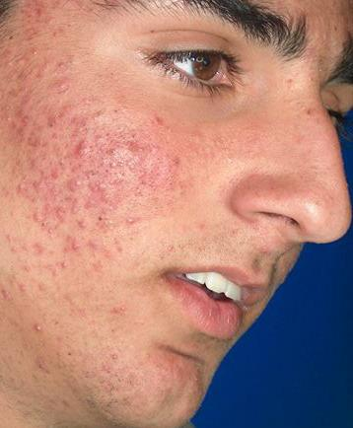
Moderate Acne
Notes:
Label photos for whoever owns them for rights

Slide 28
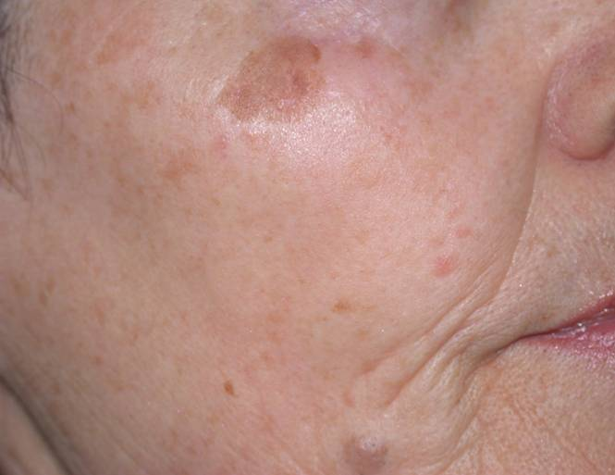
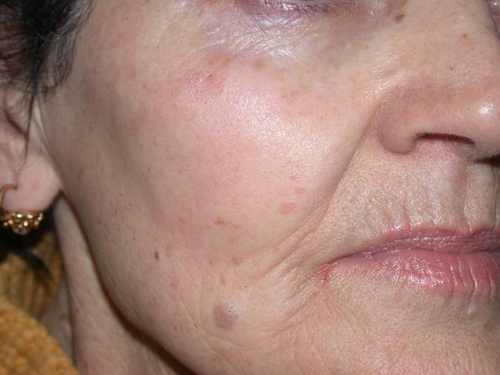
Pigmented Lesions
Notes:
Label photos for whoever they belong to for rights

Slide 29
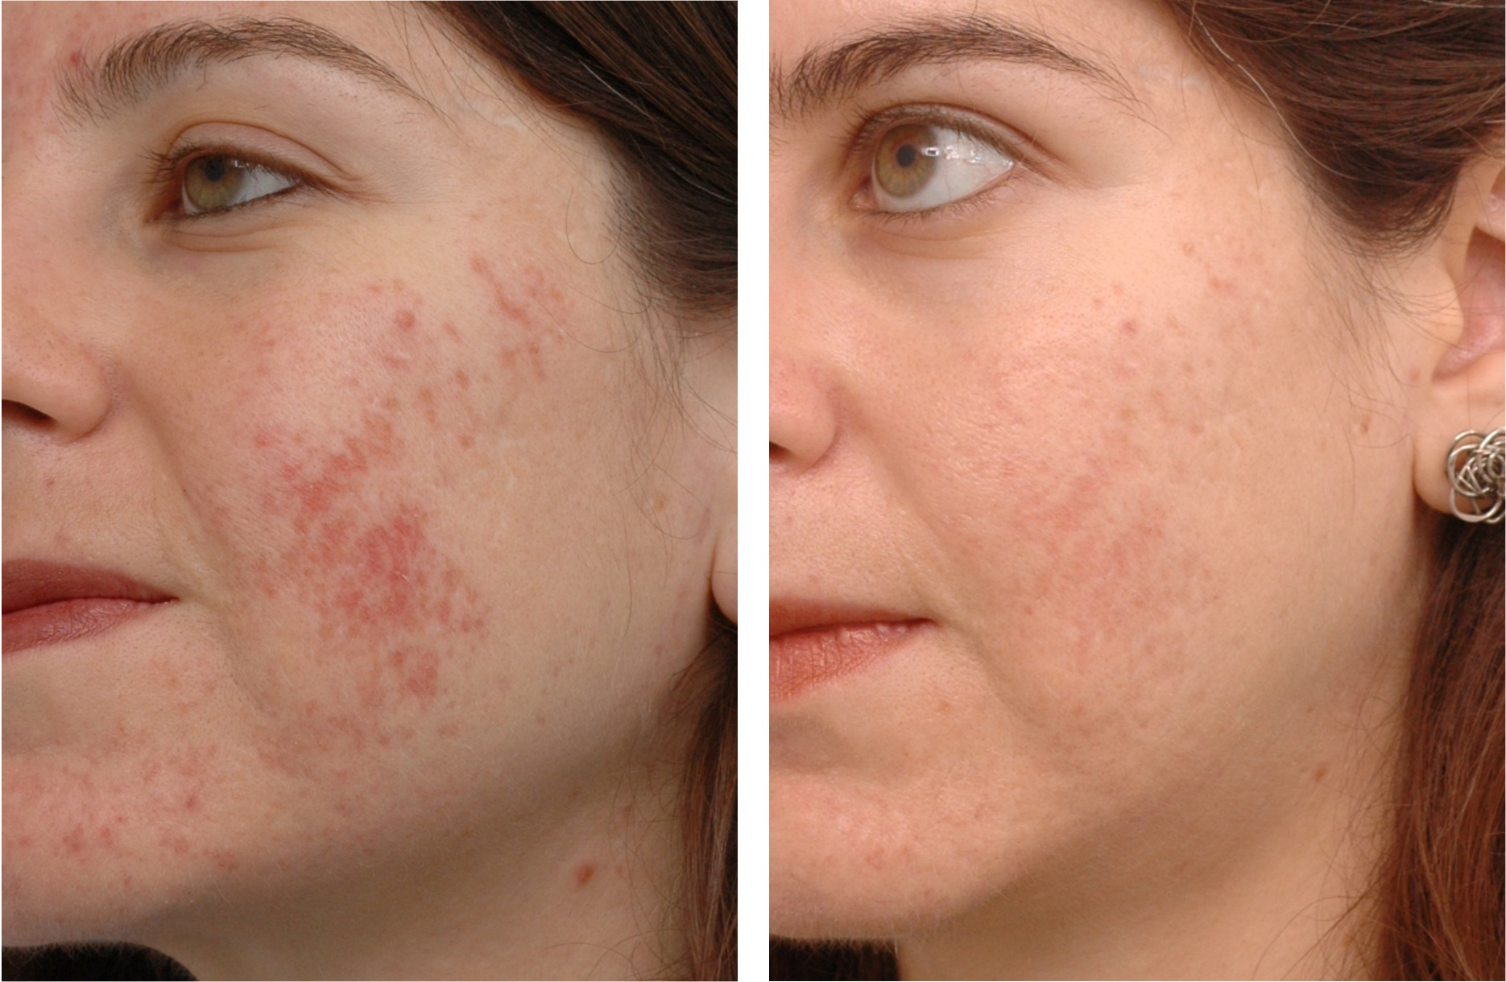
Notes:
Label photos for whoever owns them for rights

Slide 30
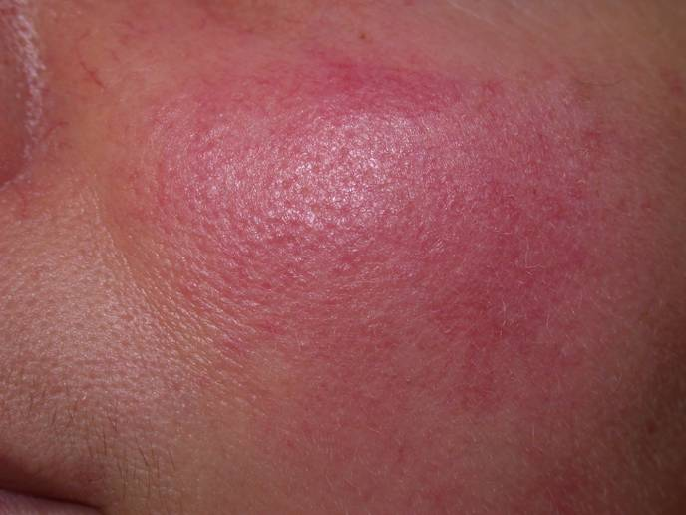
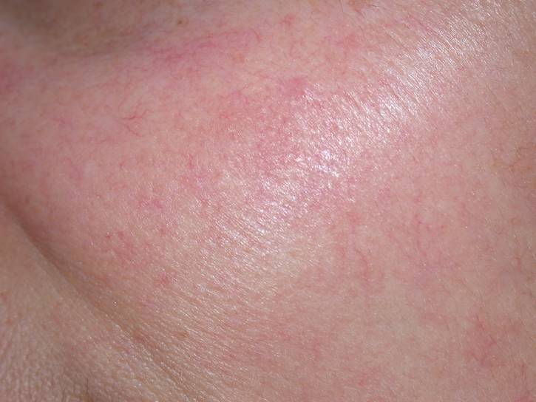
Rosacea
Notes:
Label photos for whoever owns them for rights

Slide 31
Notes:
Label photos for whoever owns them for rights

Slide 32
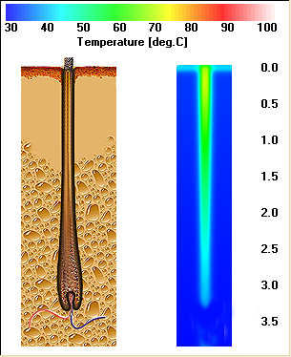
What Does Light Do?
Light penetrating through the epidermis is scattered by the dermis and absorbed by the melanin in the hair shaft.
Notes:
Done

Slide 33
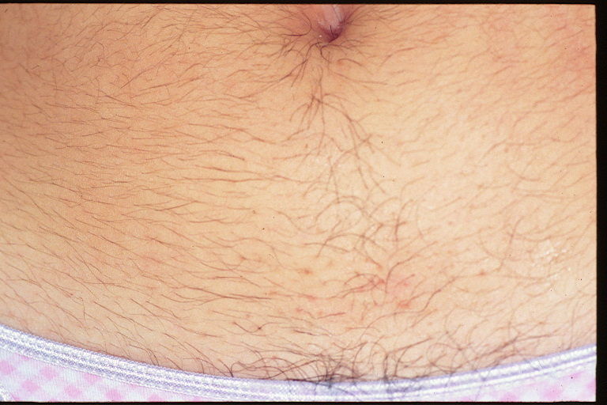
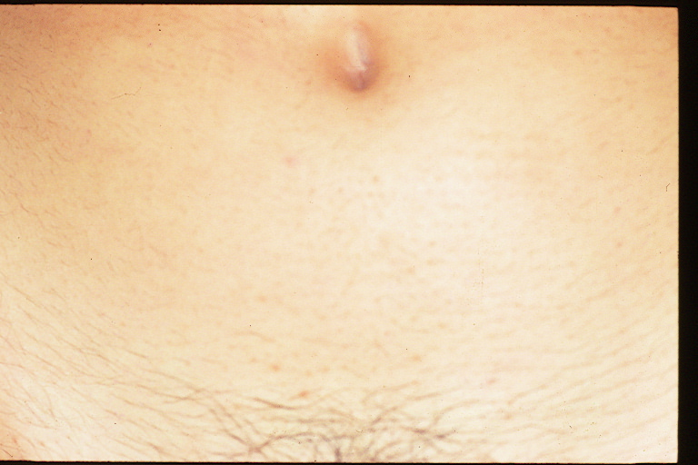
IPL Hair Removal
Notes:
Label photos for whoever owns them for rights

Slide 34
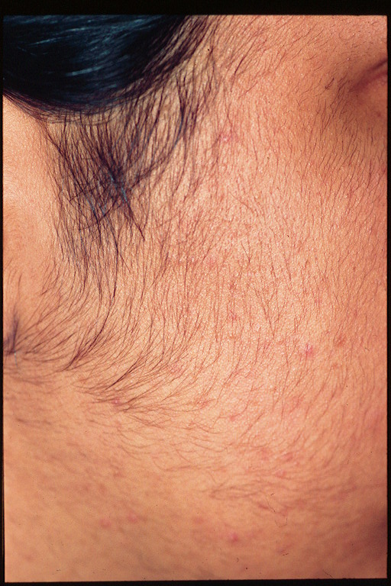
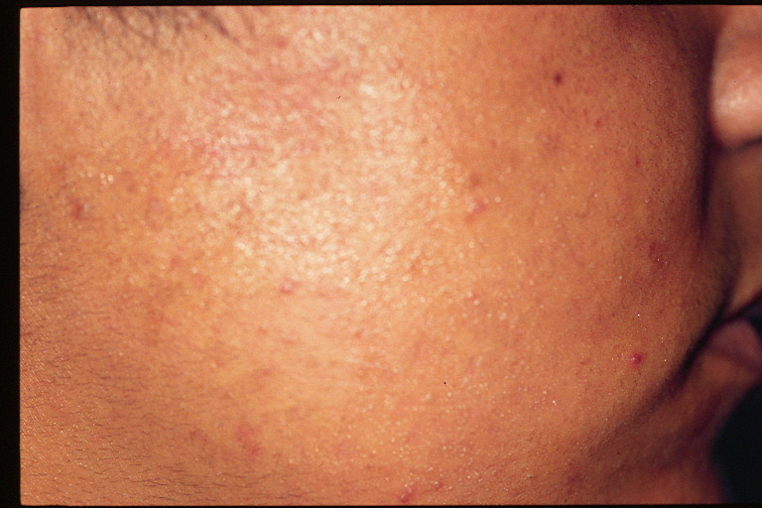
IPL Hair Removal
Notes:
Label photos for whoever owns them for rights

Slide 35
Questions?
Notes:
DONE

